Slide 1

Improvi
Go, change the world
RV College of
Engineering
Unit 1 (Introduction to Database Systems)
Original Content: Ramez Elmasri and Shamkant B. Navathe
Dr. Poonam Ghuli
Associate Professor, Department of CSE
RV College of Engineering, Bengaluru - 59

Slide 2

Contents
Go, change the world
RV College of
Engineering
Basic Definitions
Typical DBMS Functionality
Example of a Database (UNIVERSITY)
Main Characteristics of the Database Approach
Database Users
Data Models
Schemas and Instances
Three-schema Architecture and Data Independence
Database Languages and Interfaces
The Database System Environment.

Slide 3
Basic Definitions
Go, change the world
RV College of
Engineering
Database:
A collection of related data.
Data:
Known facts that can be recorded and have an implicit meaning.
Mini-world:
Some part of the real world about which data is stored in a database. For example, student grades and transcripts at a university.
Database Management System (DBMS):
A software package/ system to facilitate the creation and maintenance of a computerized database.
Database System:
The DBMS software together with the data itself. Sometimes, the applications are also included.

Slide 4
Problems with traditional approach
Go, change the world
RV College of
Engineering
Inconsistency
Redundancy
Loss of flexibility
Multiple files
Update Problem

Slide 5
Types of Databases and Database Applications
Go, change the world
RV College of
Engineering
Traditional Applications:
Numeric and Textual Databases
More Recent Applications:
Multimedia Databases
Geographic Information Systems (GIS)
Data Warehouses
Real-time and Active Databases
Many other applications

Slide 6
Typical DBMS Functionality
Go, change the world
RV College of
Engineering
Define a particular database in terms of its data types, structures, and constraints
Construct or Load the initial database contents on a secondary storage medium
Manipulating the database:
Retrieval: Querying, generating reports
Modification: Insertions, deletions and updates to its content
Accessing the database through Web applications
Processing and Sharing by a set of concurrent users and application programs – yet, keeping all data valid and consistent

Slide 7
Typical DBMS Functionality
Go, change the world
RV College of
Engineering
Other features:
Protection or Security measures to prevent unauthorized access
Presentation and Visualization of data
Maintaining the database and associated programs over the lifetime of the database application
Called database, software, and system maintenance

Slide 8
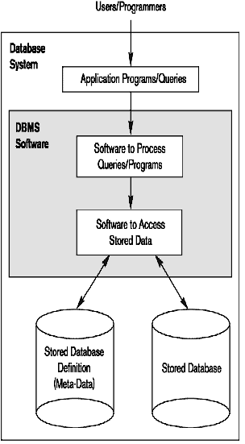
Simplified database system environment
Go, change the world
RV College of
Engineering

Slide 9
Example of a Database (with a Conceptual Data Model)
Go, change the world
RV College of
Engineering
Mini-world for the example:
Part of a UNIVERSITY environment.
Some mini-world entities:
STUDENTs
COURSEs
SECTIONs (of COURSEs)
(academic) DEPARTMENTs
INSTRUCTORs

Slide 10
Example of a Database (with a Conceptual Data Model)
Go, change the world
RV College of
Engineering
Some mini-world relationships:
SECTIONs are of specific COURSEs
STUDENTs belong to SECTIONs
COURSEs have prerequisite COURSEs
INSTRUCTORs teach SECTIONs
COURSEs are offered by DEPARTMENTs
STUDENTs major in DEPARTMENTs

Slide 11
Main Characteristics of the Database Approach
Go, change the world
RV College of
Engineering
Self-describing nature of a database system:
A DBMS catalog stores the description of a particular database (e.g. data structures, types, and constraints)
The description is called meta-data.
This allows the DBMS software to work with different database applications such as University DB, Banking DB or Company DB.
Insulation between programs and data:
Called program-data independence.
Allows changing data structures and storage organization without having to change the DBMS access programs.

Slide 12
Main Characteristics of the Database Approach
Go, change the world
RV College of
Engineering
Data Abstraction:
The characteristic that allows program-data independence and program-operation independence
Program-operation independence
User application programs can operate on the data by invoking operations through their names and arguments, regardless of how the operations are implemented
A data model is used to hide storage details and present the users with a conceptual view of the database.
Relational model hides how the data is stored and how the operations are implemented. DB is represented in terms of entities, attributes and relationships among entities that is understood by most users.
Programs refer to the data model constructs rather than data storage details
Support of multiple views of the data:
Each user may see a different view of the database, which describes only the data of interest to that user.

Slide 13
Main Characteristics of the Database Approach
Go, change the world
RV College of
Engineering
A DBMS must enforce following transaction properties
Isolation
Each transaction appears to execute in isolation from other transactions.
Atomicity
Either all the database operations in a transaction are executed or none are.
Concurrency control within the DBMS guarantees that each transaction is correctly executed or aborted
Recovery subsystem ensures each completed transaction has its effect permanently recorded in the database
OLTP (Online Transaction Processing) is a major part of database applications. This allows hundreds of concurrent transactions to execute per second.

Slide 14
Database Users
Go, change the world
RV College of
Engineering
Users may be divided into
Those who actually use and control the database content, and those who design, develop and maintain database applications (called “Actors on the Scene”), and
Those who design and develop the DBMS software and related tools, and the computer systems operators (called “Workers Behind the Scene”).

Slide 15
Database Users
Go, change the world
RV College of
Engineering
Actors on the scene
Database Administrators:
Responsible for authorizing access to the database, for coordinating and monitoring its use, acquiring software and hardware resources, controlling its use and monitoring efficiency of operations.
Database Designers:
Responsible to define the content, the structure, the constraints, and functions or transactions against the database. They must communicate with the end-users and understand their needs.
System Analysts and Application Programmers (Software Engineers)
Familiar with the full range of capabilities provided by the DBMS to accomplish their tasks

Slide 16
Categories of End-users
Go, change the world
RV College of
Engineering
End-users: They use the data for queries, reports and some of them update the database content. End-users can be categorized into:
Casual: access database occasionally when needed
Naïve or Parametric: they make up a large section of the end-user population.
They use previously well-defined functions in the form of “canned transactions” against the database.
Examples are bank-tellers or reservation clerks who do this activity for an entire shift of operations.
Sophisticated:
These include business analysts, scientists, engineers, others thoroughly familiar with the system capabilities.
Many use tools in the form of software packages that work closely with the stored database.
Stand-alone:
Mostly maintain personal databases using ready-to-use packaged applications.
An example is a tax program user that creates its own internal database.
Another example is a user that maintains an address book

Slide 17
Workers behind the Scene
Go, change the world
RV College of
Engineering
DBMS System Designers and Implementers
Design and implement the DBMS modules and interfaces as a software package
Tool Developers
Design and implement tools – the software packages that facilitate database modeling and design, database system design, and improved performance
Operators and Maintenance Personnel
Responsible for the actual running and maintenance of the hardware and software environment for the database system

Slide 18
Data Models
Data Abstraction
Suppression of details of data organization and storage and the highlighting of the essential features for an improved understanding of data
Data Model:
A collection of concepts to describe the structure of a database, the operations for manipulating these structures, and certain constraints that the database should obey.
It provides necessary means to achieve data abstraction
Data Model Structure and Constraints:
Constructs are used to define the database structure
Constructs typically include elements (and their data types) as well as groups of elements (e.g. entity, record, table), and relationships among such groups
Constraints specify some restrictions on valid data; these constraints must be enforced at all times

Slide 19
Data Models
Go, change the world
RV College of
Engineering
Data Model Operations:
These operations are used for specifying database retrievals and updates by referring to the constructs of the data model.
Operations on the data model may include basic model operations (e.g. generic insert, delete, update) and user-defined operations (e.g. compute_student_gpa, update_inventory)

Slide 20
Categories of Data Models
Go, change the world
RV College of
Engineering
Conceptual (high-level, semantic) data models:
Provide concepts that are close to the way many users perceive data.
(Also called entity-based or object-based data models.)
Physical (low-level, internal) data models:
Provide concepts that describe details of how data is stored in the computer. These are usually specified in an ad-hoc manner through DBMS design and administration manuals
Implementation (representational) data models:
Provide concepts that fall between the above two, used by many commercial DBMS implementations (e.g. relational data models used in many commercial systems).

Slide 21
Database Schema
Go, change the world
RV College of
Engineering
Database Schema
The description of a database.
Includes descriptions of the database structure, data types, and the constraints on the database.
Schema Diagram
An illustrative display of (most aspects of) a database schema.
Schema Construct
A component of the schema or an object within the schema, e.g., STUDENT, COURSE.

Slide 22
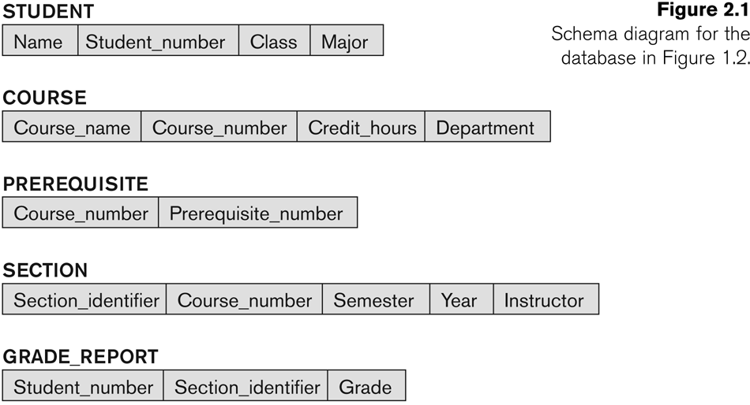
Example of a Database Schema
Go, change the world
RV College of
Engineering

Slide 23
Database State
Go, change the world
RV College of
Engineering
Database State
The actual data stored in a database at a particular moment in time. This includes the collection of all the data in the database.
Also called database instance (or occurrence or snapshot).
The term instance is also applied to individual database components, e.g. record instance, table instance, entity instance
Refers to the content of a database at a moment in time.
Initial Database State
Refers to the database state when it is initially loaded into the system.
Valid State
A state that satisfies the structure and constraints of the database.

Slide 24
DB Schema v/s DB State
Go, change the world
RV College of
Engineering
Distinction
The database schema changes very infrequently.
The database state changes every time the database is updated.
Schema is also called intension.
State is also called extension.

Slide 25
Three-Schema Architecture
Go, change the world
RV College of
Engineering
Proposed to support DBMS characteristics of:
Program-data independence.
Support of multiple views of the data.
Its goal is to separate the user applications and the physical database.
Not explicitly used in commercial DBMS products, but has been useful in explaining database system organization

Slide 26
The Three-Schema Architecture
Go, change the world
RV College of
Engineering
Defines DBMS schemas at three levels:
Internal schema at the internal level to describe physical storage structures and access paths (e.g indexes).
Typically uses a physical data model.
Conceptual schema at the conceptual level to describe the structure and constraints for the whole database for a community of users. It describes entities, data types, relationships, user operations and constraints.
Uses a conceptual or an implementation data model.
External schemas at the external level (or view level) to describe the various user views.
Usually uses the same data model as the conceptual schema.

Slide 27
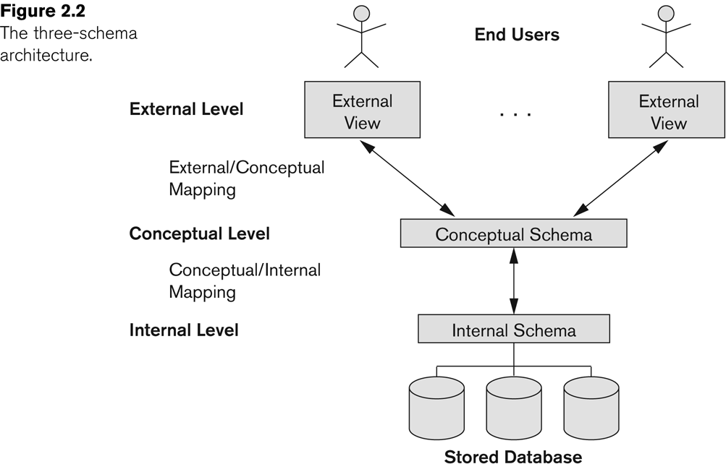
The Three-Schema Architecture
Go, change the world
RV College of
Engineering

Slide 28
Data Independence
Go, change the world
RV College of
Engineering
Logical Data Independence:
The capacity to change the conceptual schema without having to change the external schemas and their associated application programs.
Physical Data Independence:
The capacity to change the internal schema without having to change the conceptual schema.
For example, the internal schema may be changed when certain file structures are reorganized or new indexes are created to improve database performance

Slide 29
Data Independence
Go, change the world
RV College of
Engineering
When a schema at a lower level is changed, only the mappings between this schema and higher-level schemas need to be changed in a DBMS that fully supports data independence.
The higher-level schemas themselves are unchanged.
Hence, the application programs need not be changed since they refer to the external schemas.

Slide 30
DBMS Languages
Go, change the world
RV College of
Engineering
Data Definition Language (DDL)
Data Manipulation Language (DML)
High-Level or Non-procedural Languages: These include the relational language SQL
May be used in a standalone way or may be embedded in a programming language
Low Level or Procedural Languages:
These must be embedded in a programming language

Slide 31
DBMS Languages
Go, change the world
RV College of
Engineering
Data Definition Language (DDL):
Used by the DBA and database designers to specify the conceptual schema of a database.
In many DBMSs, the DDL is also used to define internal and external schemas (views).
In some DBMSs, separate storage definition language (SDL) and view definition language (VDL) are used to define internal and external schemas.
SDL is typically realized via DBMS commands provided to the DBA and database designers

Slide 32
DBMS Languages
Go, change the world
RV College of
Engineering
Data Manipulation Language (DML):
Used to specify database retrievals and updates
DML commands (data sublanguage) can be embedded in a general-purpose programming language (host language), such as COBOL, C, C++, or Java.
A library of functions can also be provided to access the DBMS from a programming language
Alternatively, stand-alone DML commands can be applied directly (called a query language).

Slide 33
Types of DML
Go, change the world
RV College of
Engineering
High Level or Non-procedural Language:
For example, the SQL relational language
Are “set”-oriented and specify what data to retrieve rather than how to retrieve it. Many records can be retrieved in one DML statement
Also called declarative languages.
Low Level or Procedural Language:
Retrieve data one record-at-a-time;
Constructs such as looping are needed to retrieve multiple records, along with positioning pointers.

Slide 34
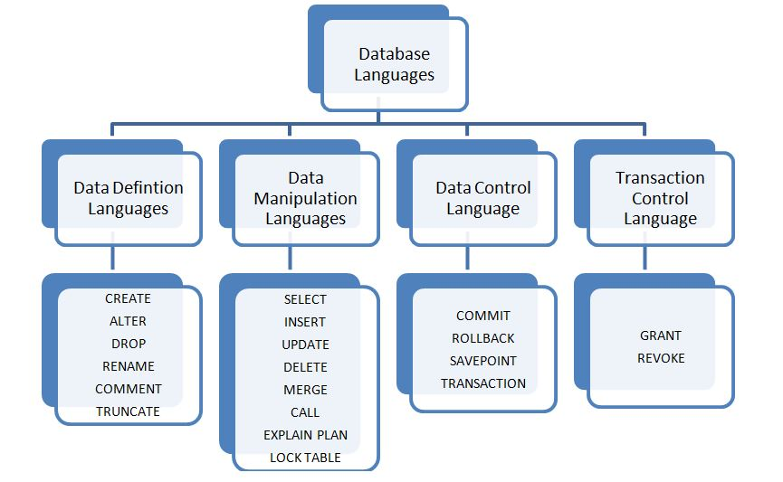
DBMS Languages
Go, change the world
RV College of
Engineering

Slide 35
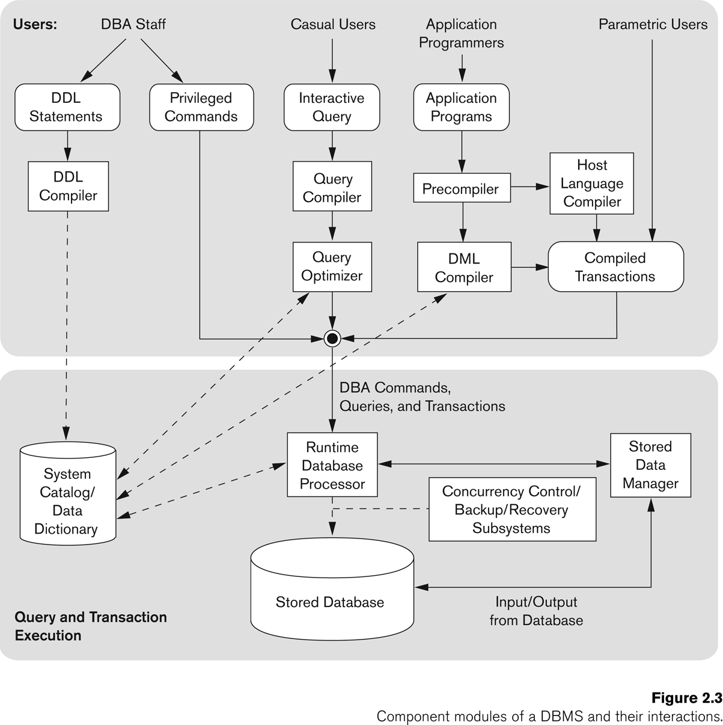
Typical DBMS Component Modules
Go, change the world
RV College of
Engineering

Slide 36
Go, change the world
RV College of
Engineering
Thank YOU

